Slide 1
Content
Video games industry.
Negative effects of violent video games.
Proposed solutions to the
References .

Slide 2

Video Games Industry
Growth of the gaming Industry
Types of video games.
Target market for video games.
Notes:
Video games are among the most popular source of entertainment for the current youth generation. I researched the sector, and my findings indicated that violent video games are among the most popular type of games of all. . The audience or market target of these video producing companies and their product comprises mainly of the college students and teenagers. Youths seem to be addicted to these games as their sole source of entertainment and the only way to spend quality time with friends.

Slide 3

Negative effects of Violent Video Games:
It promotes aggression.
Develops negative personal attitude.
Encourages moral disengagement.
Reduces one’s empathy levels.
Notes:
Exposure to violent video games can temporarily increase the aggression of the students through the activation of their aggressive domains . Video games require players to involve their minds and full attention during the process. As a result, their thoughts and feelings are occupied by the game as well as psychological arousal and overall behavior. The violent video games also assist in shaping of one's behavior, attitude, and encourages moral disengagement. Youths and teenagers tend to watch and copy the content of whatever material they get exposed to most of the time. Such imitations can lead to teenagers engaging in online wars, cyberbullying, and other criminal related complications.

Slide 4
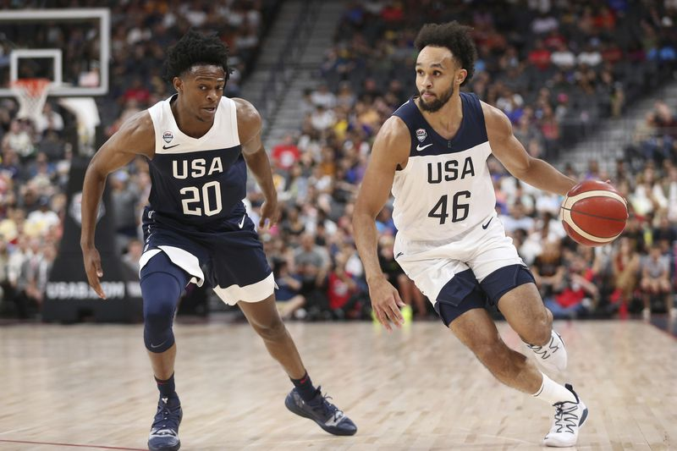
Proposed solutions
Self Regulation.
Legislation by the Government.
Content regulation by the producer.
Diversion to cocurricular activities.
Notes:
The government can put in place restrictions on the content of video games to be released. Gaming producers can also restrict the purchasing of their product by underaged children and students. The major solutions to this nightmare lie with the youths who should self regulate themselves and spend little time Infront of the screen.

Slide 5
References
Barton, E. K. (2014). Game over Legal response to video game violence. Notre Dame Journal of
Law, Ethics & Public Policy, 16(1), 133-171
Hollingdale, J. (2014). The effect of online violent video games on levels of aggression. PLOS
ONE, 9(11), doi.org/10.1371/journal.pone.0111790
Kimming, A. S., Andringa, G., & Derntl, B. (2018). Potential adverse effects of violent video
gaming: Interpersonal-Affective traits are rather impaired than disinhibition in young adults. Frontiers in Psychology, 9(736), doi: 10.3389/fpsyg.2018.00736
Meyers, S. K. (2002). Television and video game violence: age differences and the combined
effects of passive and interactive violent media. LSU Doctoral Dissertations. Retrieved from https://digitalcommons.lsu.edu/gradschool_dissertations/2214
Shao, R & Wang, Y. (2019). The relation of violent video games to adolescent aggression: An
examination of moderated mediation effect. Frontiers in Psychology, 10(384). doi: 10.3389/fpsyg.2019.00384

